Slide 1
Getting Started with Kotlin

Slide 2
Contents
Setting the scene
Kotlin tools
Kotlin and IntelliJ

Slide 3
1. Setting the Scene
What is Kotlin?
Kotlin and Java
Kotlin and server-side development
Kotlin and JavaScript
Kotlin Multiplatform
Kotlin/Native

Slide 4

What is Kotlin?
Kotlin is a Java-based language from JetBrains
Named after Kotlin Island near St. Petersburg
Kotlin timeline
Feb 2016 - Kotlin 1.0 released, first stable release
Mar 2017 - Kotlin 1.1 released, added support for JS
May 2017 - Google announce support for Kotlin on Android
…
July 2023 - Kotlin 1.9 released, a few new language/API features

Slide 5
Kotlin and Java
Kotlin/JVM is a Java-based language
When you compile Kotlin, it compiles to Java bytecodes
You run Kotlin applications on the JVM
Kotlin code can interoperate freely with Java code
There's also an automated Java-to-Kotlin code converter ☺
Kotlin source code
Java source code
Kotlin compiler
Java compiler
Java
bytecodes
Java
bytecodes
JVM

Slide 6
Kotlin and Server-Side Development
Kotlin is a popular choice for server-side development
Great multithreading capabilities (via coroutines)
Support for Spring Framework / Spring Boot
Many other libraries (e.g. Ktor for web apps, see https://ktor.io)
You can deploy Kotlin apps to any host that supports Java web apps, such as:
Amazon Web Services
Google Cloud Platform
Heroku Cloud Platform
Azure

Slide 7
Kotlin and JavaScript
You can use Kotlin as an alternative to JavaScript
You can transpile Kotlin code into ECMAScript
Why use Kotlin as an alternative to JavaScript?
You can leverage the Kotlin programming language
You can leverage the Kotlin APIs, to wrap DOM complexities
You can use Kotlin alongside existing JS libraries
E.g. jQuery, React, Angular
Use the dukat tool to convert TypeScript definitions to Kotlin

Slide 8
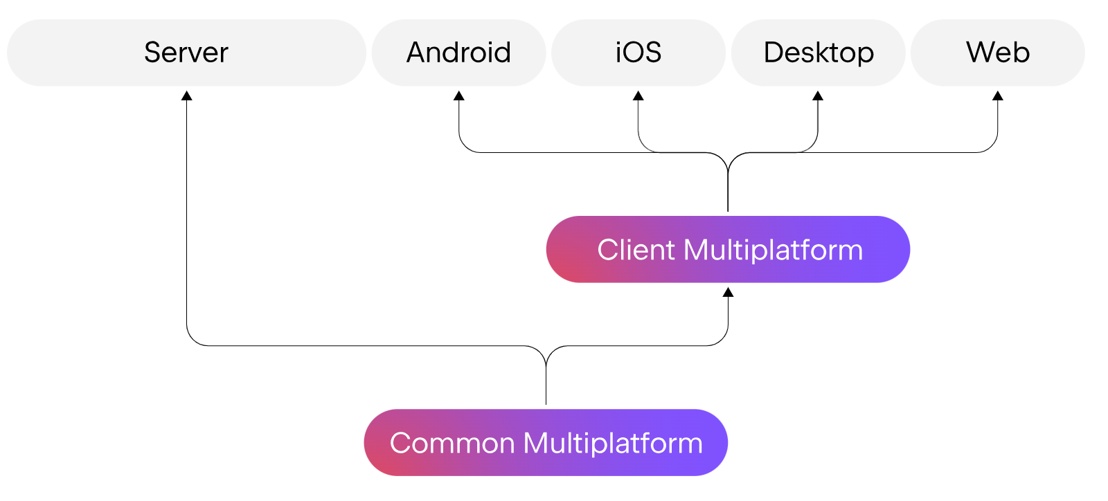
Kotlin Multiplatform
Kotlin Multiplatform makes it easier to implement cross-platform systems

Slide 9
Kotlin/Native
Kotlin/Native is a technology for compiling Kotlin code to native binaries
You can run the binaries natively on the O/S (no VM)
Why use Kotlin/Native:
On platforms where virtual machines are undesirable or impossible
E.g. embedded devices, iOS
Target platforms supported:
iOS (arm32, arm64, simulator x86_64)
MacOS (x86_64)
Android (arm32, arm64)
Windows (mingw x86_64, x86)
Linux (x86_64, arm32, MIPS, MIPS little endian, Raspberry Pi)

Slide 10
2. Kotlin Tools
Using the Kotlin playground
Installing the Kotlin compiler
Using the Kotlin compiler
Kotlin IDE support

Slide 11
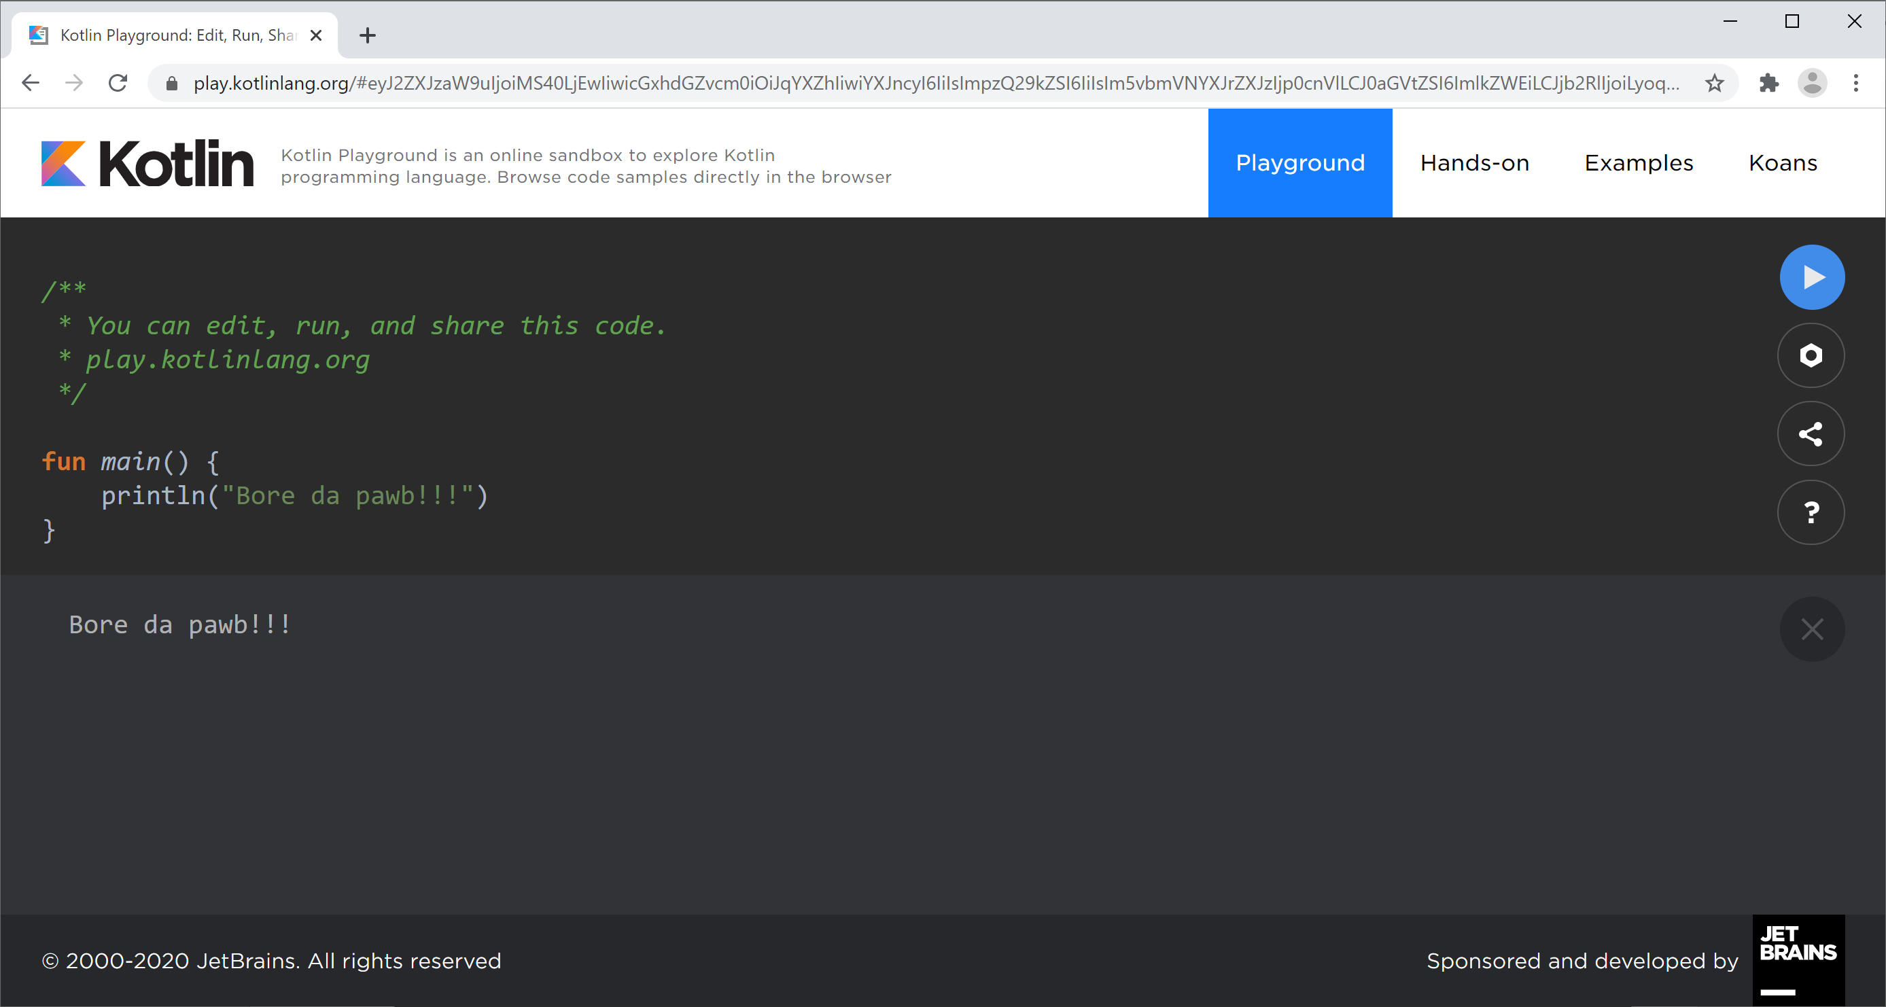
Using the Kotlin Playground
There's a handy online Kotlin playground, where you can type-in and run Kotlin code
https://play.kotlinlang.org
Type code here
Then click here
Console output is displayed here

Slide 12
Installing the Kotlin Compiler
You can install the Kotlin compiler locally
So you can compile Kotlin code at the command line
First you must install the JDK
JDK 8+ is preferred
Then install the Kotlin compiler - we're using Kotlin 1.9
Go to https://github.com/JetBrains/kotlin/releases/tag/v1.9.20
Download appropriate compiler, e.g. kotlin-compiler-1.9.20.zip
Unzip, and add the bin folder to your path

Slide 13
Using the Kotlin Compiler
Here's a simple Kotlin program
Use the Kotlin compiler, to compile into Java bytecodes
Creates a file named HelloWorldKt.class
Run the compiled Java bytecodes
Via the kotlin script
fun main() {
println("Hei verden fra Kotlin!")
}
HelloWorld.kt
kotlinc HelloWorld.kt
kotlin HelloWorldKt

Slide 14
Kotlin IDE Support
Many IDEs have support for Kotlin, including:
IntelliJ (Community or Ultimate)
Android Studio
Eclipse
NetBeans
Several text editors have support for Kotlin too, including:
VS Code
Sublime Text
Vim

Slide 15
3. Kotlin and IntelliJ
Overview
Creating a Kotlin project
Reviewing the project structure
Running the application

Slide 16
Overview
IntelliJ IDEA has excellent support for Kotlin
Hardly surprising, as JetBrains were the originators of Kotlin
In this section we'll see how to create a simple Kotlin module in IntelliJ IDEA
So, run IntelliJ and let's get started…

Slide 17
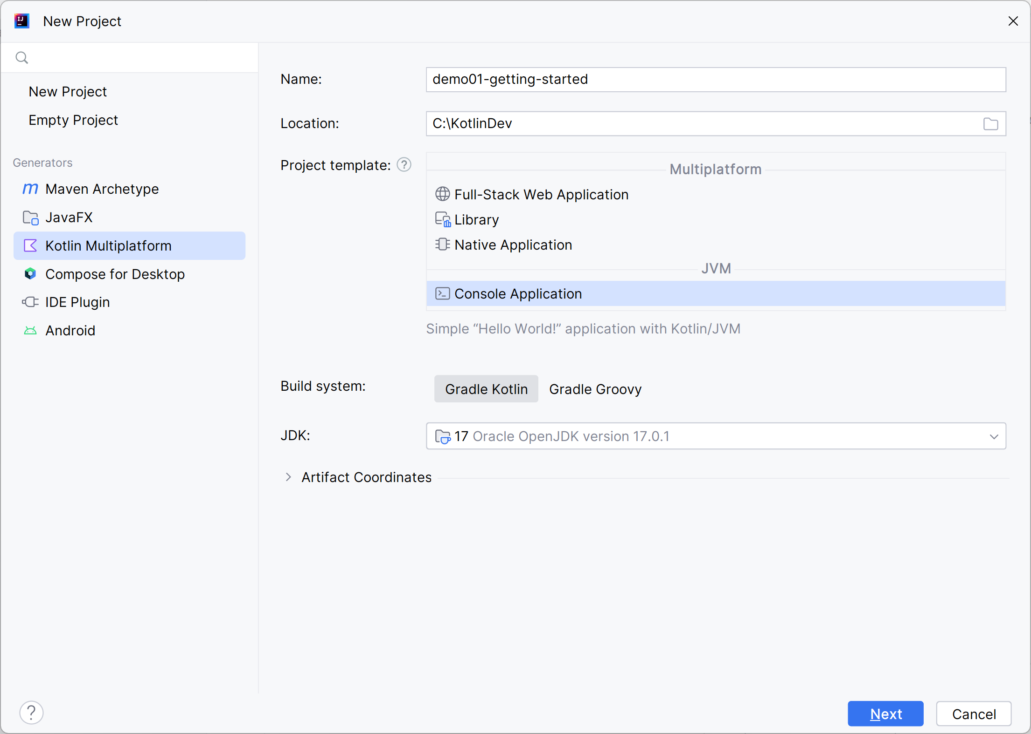
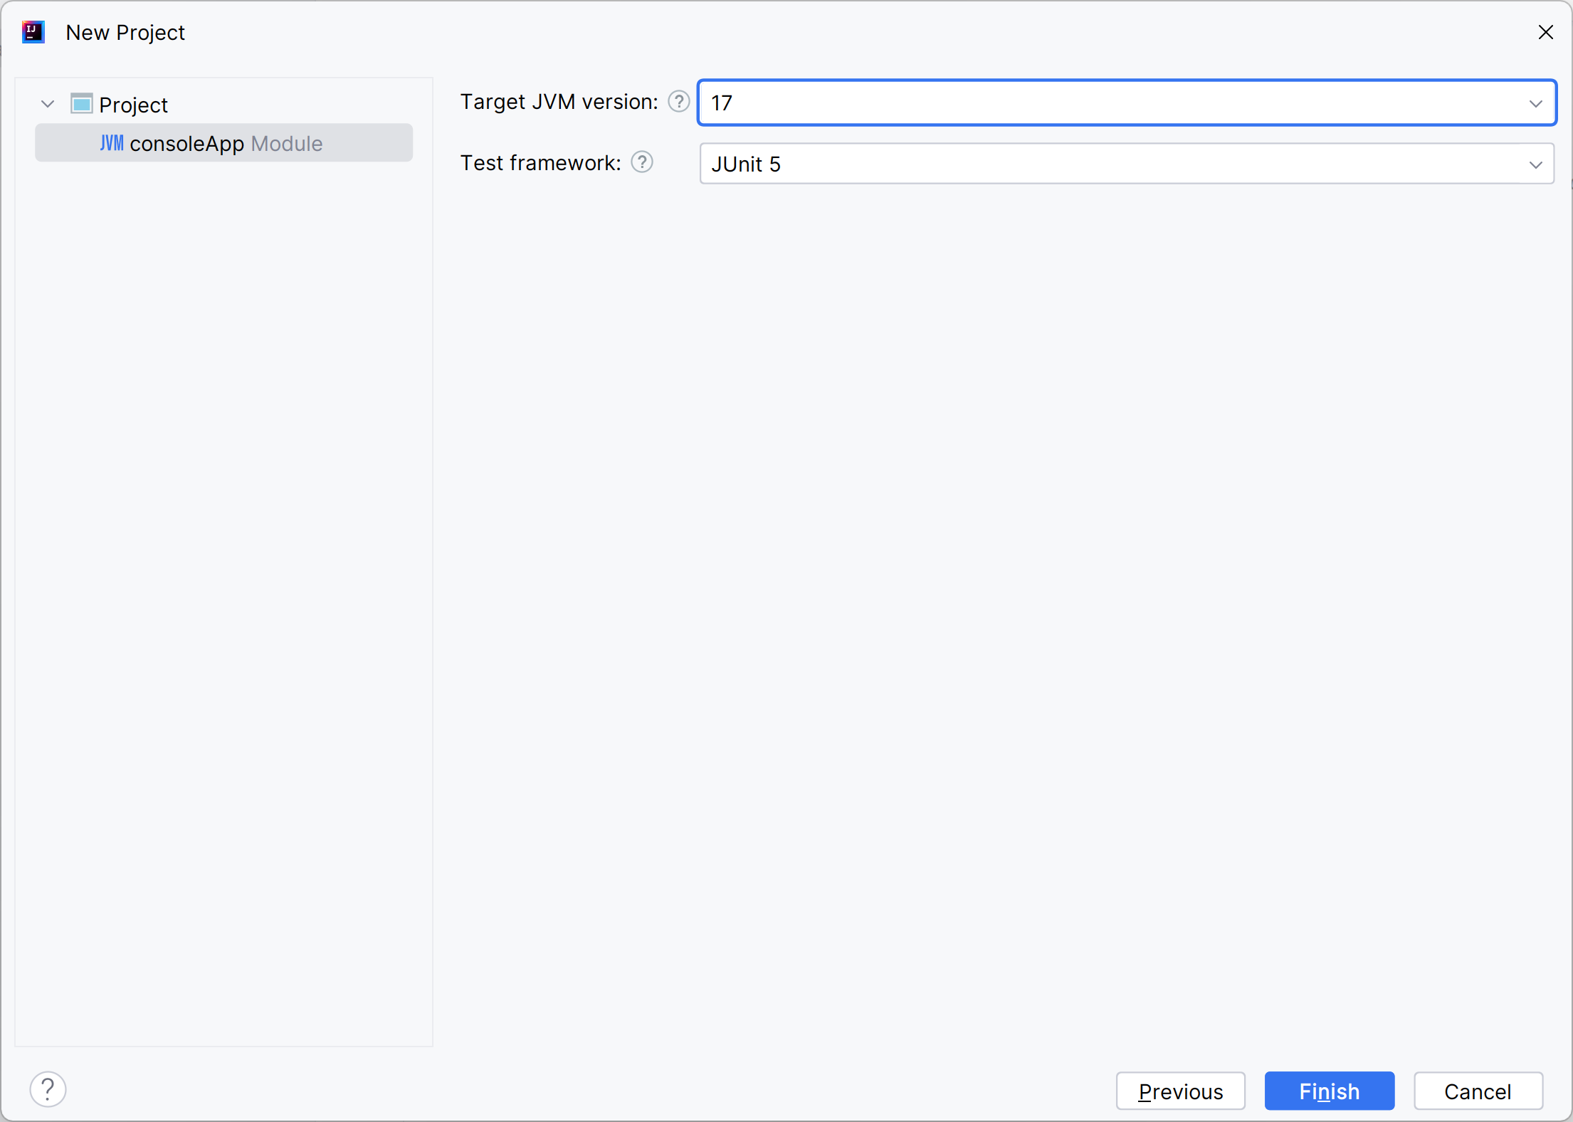
Creating a Kotlin Project
Click File | New | Project and specify these details:

Slide 18
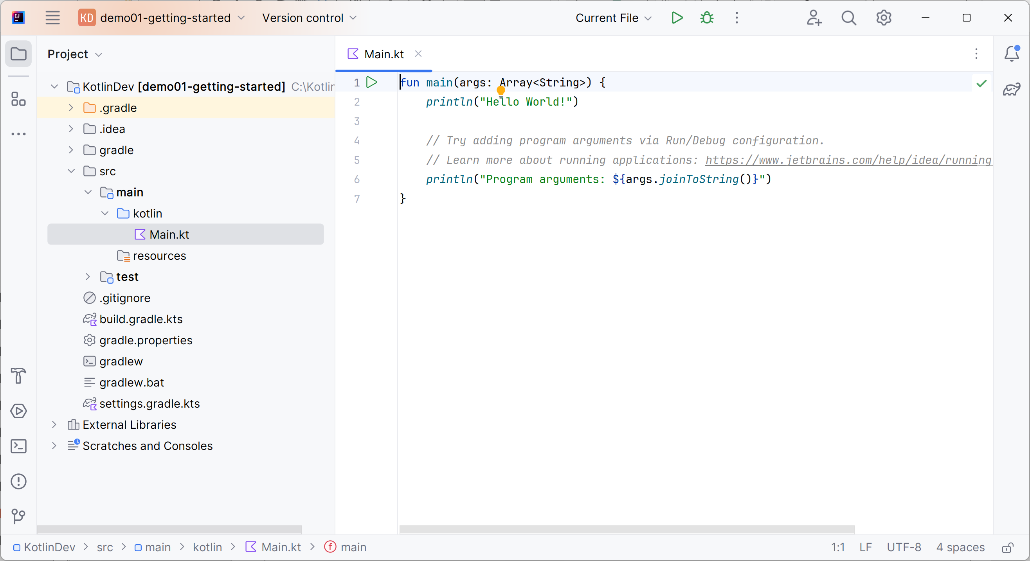
Reviewing the Project Structure
IntelliJ generates a standard-format (Gradle) project

Slide 19
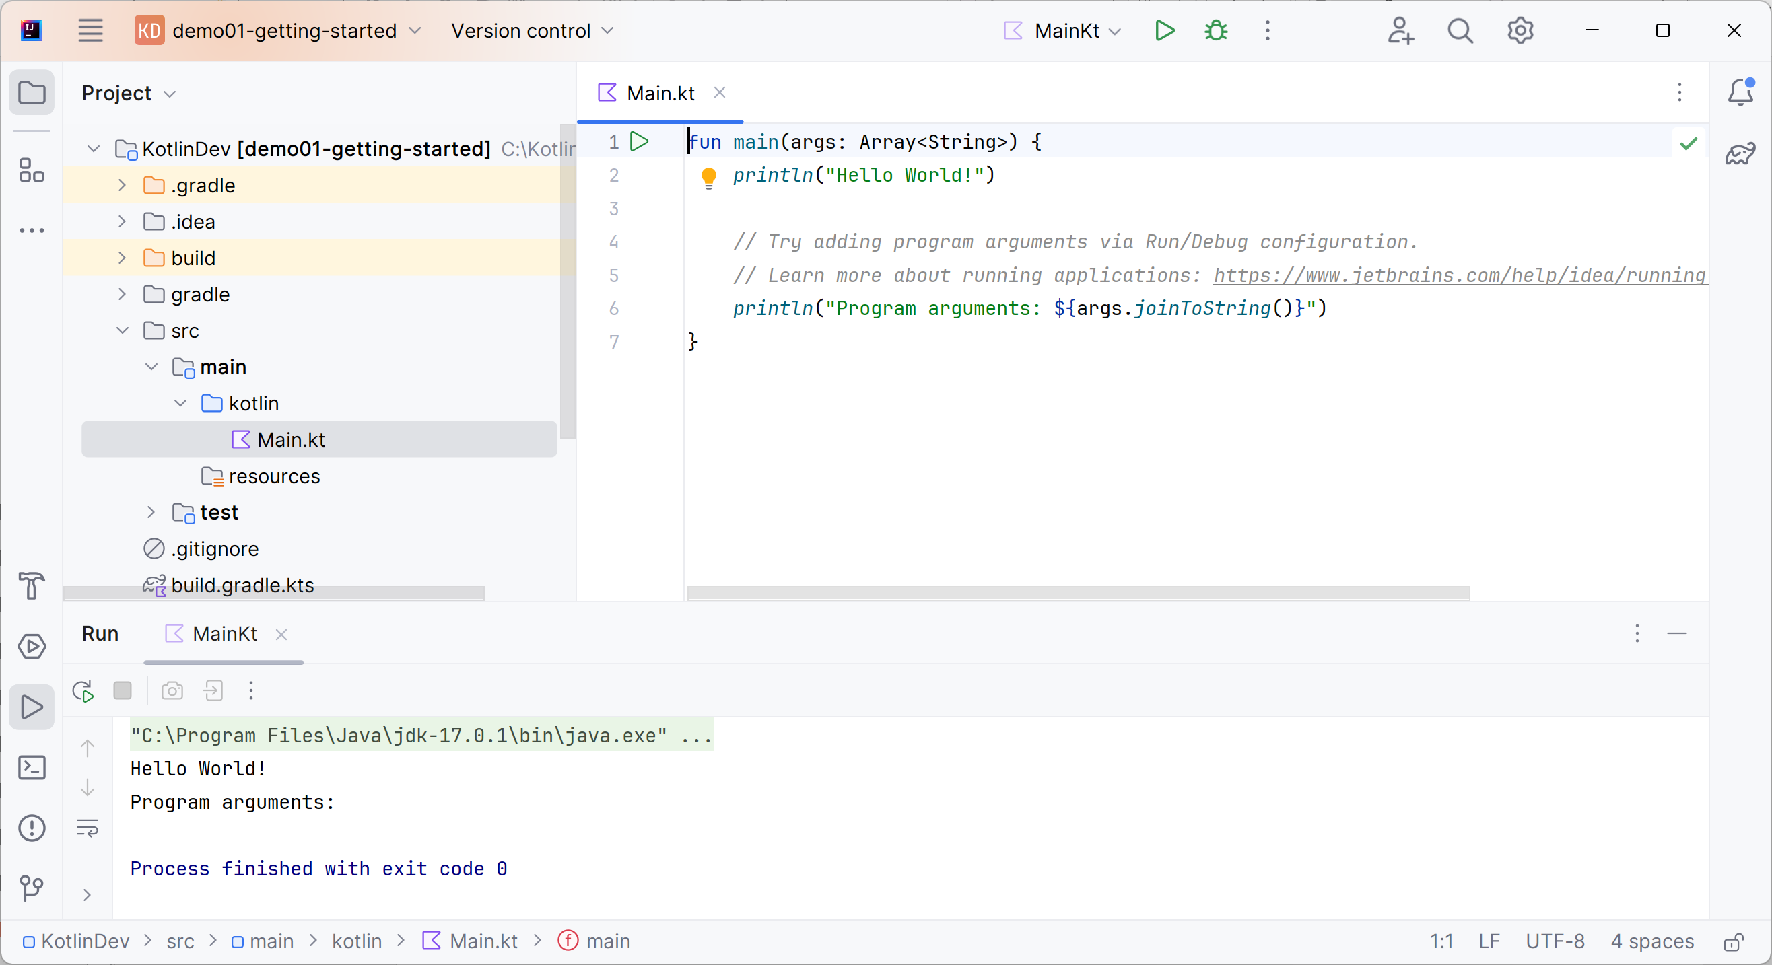
Running the Application
Run the application and take a look at the console

Slide 20
Any Questions?

